Slide 1

“ ENGINEERED TO EXCEL TECHNOLOGY TO PERFORM”
MANINDER SINGH
(Business Consultant ) Email : precastmarketing@buildmate.in Mobile :
+91 9560450535
BUILDMATE PROJECTS PVT LTD
SY NO 60 61 62 N H 7,GUNDLAPOCHAMPALLY VILLAGE MEDCHAL MANDAL, NH-7, Medchal Road Hyderabad - 500014, Telangana, India
www.buildmate.in

Slide 2
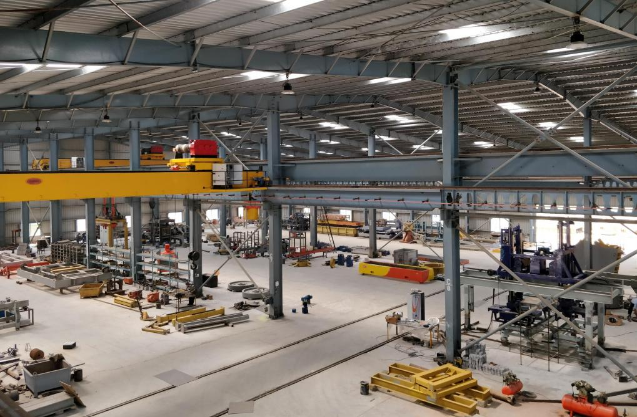
Buildmate Project Pvt Ltd
Since 1991, Unrelenting adherence to our values, the core of which are Quality, Integrity, and Innovative Approach. Fabrication Unit in Hyderabad, INDIA.
Manufacturing Unit is in Hyderabad. The factory spreads up in 2,85,000 sq.ft area .
The present workshop in 100,000 Sft is well equipped with EOT cranes, stores and reasonably good office along with all the need-based equipment like Profile cutting machine, welding machined, drilling equipment, lathe machine and milling machines are available in place to carry out smooth manufacturing activities.
GLOBAL PRESENCE
BUILDMATE production accounts for its prestigious clients are situated in INDIA and Saudi Arabia, Middle East, Bhutan, Asian Countries and East Africa.

Slide 3
Our product are delivered at Economic prices with Technology
Equal or Better than Europen standards.
TAILOR-MADE SOLUTIONS
ONE POINT SOLUTION
BUILDMATE being a turnkey contracting company is capable of providing a complete range of project services needed to conceptualize, plan, design, engineer and construct the projects to meet the specific requirements of its clients. Apart from Precast Production machines & Equipment, Buildmate can fully support the customer with In-house built ancillary equipment and process.
We work for following Industries-
AAC Plant Machinery Precast Machinery Batching Plants & Mixers Stone Crushing Plants Dry Mix Mortar Plants
Concrete Brick Block Plants Cranes
Special Projects
Pre-Engineered Buildings

Slide 4





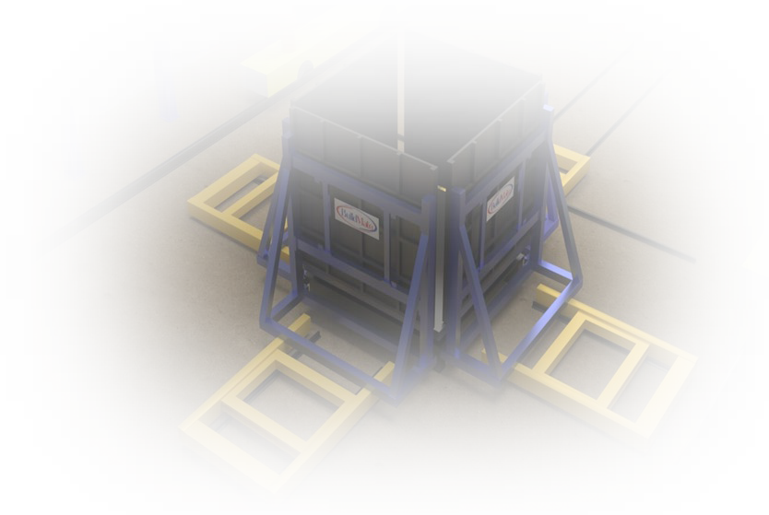
PRECAST Product Range & Description
STANDARD Precast Production Solutions
STATIONARY BEDS (PALLETS)
TILTING TABLES
BATTERY MOLD
MOLDS FOR COLUMNS & BEAMS
3 D MOLDS ( Bathroom/ Kitchen PODS)
MOLDS FOR STAIRCASE
HOLLOW CORE LINES- EXTRUDER
Machines in CAROUSEL PRECAST PLANT
PALLETS TRANSPORT
CLEANING MACHINE
PLOTTING & COMBINED MACHINE
CONCRETE SPREADING MACHINE
SURFACE SMOOTHING MACHINE
TURNING MACHINE
PALLET STACKING MACHINE
CURING CHAMBER
TILTING STATION & DEMOLDING EQUIPMENT
TRANSFER & CARRIAGE MACHINES
5

Slide 5

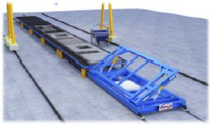
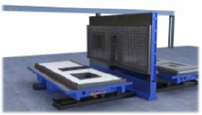
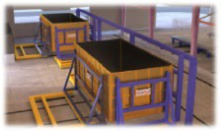
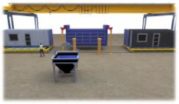
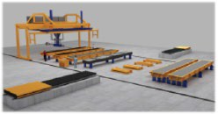
BUILDMATE IMROVISED SMART
Concrete Precast Production Solutions for
INDIAN PRECAST Market
VTC (VIBRATE TILT CAR) LINE PRODUCTION MOLDS
MULTIPURPOSE HYBRID CASTING BEDS
3 D VOLUME MOLDS
HIGH PRODUCTION – SHUTTLE TYPE BATTERY MOLD
HOLLOW CORE INDIVIDUAL TABLES PRODUCTION
HIGH PRODUCTION – CAROUSAL PLANTS

Slide 6
VTC (VIBRATE TILT CAR) LINE PRODUCTION MOLDS
Using Single movable Tilting frame & common Compacting system for all Pallets to avoid individual requirement of Hydraulics cylinders, external vibrators etc. on each table
Economical Plant to produce concrete walls/slabs on the same line, thus avoiding extra investment
Minimum Civil work on Factory shed & foundations as Rail system works as support
Designed & suitable for Moveable field factory with Simple & quick assembly & disassembly
All equipment designed to be useable in the next Upgradation to a Pallet Circulation Plant

Slide 7
MULTIPURPOSE CASTING BED flexible to use as TILTING TABLE and BATTERY MOLD
Suitable for Production of Energy Efficient Insulated Sandwich Wall Panels at site or Factory
Advantages for the User:
Lower investment costs than available conventional Battery solutions
Easy Horizontal preparation, so Measuring with laser projection also possible for accurate quality checks
The battery casting platforms can also be used without the Battery as a replacement for a separate Tilting table
Option of both side Smooth (No Plaster) surfaces Element
Option of Efficient heating system
Reduction of production costs

Slide 8
3 D VOLUME POD MOLDS ( Bottom Slab Casting)
To achieve a high production target of concrete pods in a day ( say 2 cycles per day), after considering various types of form works, it is highly recommended to use bottom slab casting system and move the bottom base frame along with green concrete element for steam curing without hooking the concrete POD till it attains maximum desired design strength which can be erected in project site directly.
This system ensure highest quality of concrete products with least possible chances of wastage /corner damages.
This system results in avoiding to target high early strength concrete as there is no hooking of green concrete elements & standard mix design like in situ concrete can be adopted which will save considerable cost of concrete
2 castings with cycle time of 10- 12 hours achievable .

Slide 9
HIGH PRODUCTION – SHUTTLE TYPE BATTERY MOLD
Advantages for the User
Assured Repetitive High mechanized production Cycles – Two minimum per day
Mechanized Process with less labor dependence
The vibration-optimized design ensures optimum compaction and the best surface finish

Slide 10
HOLLOW CORE INDIVIDUAL TABLES PRODUCTION
Evade heavy investment on Extruder/ Slip former setup.
Each Hollow-core slab element is produced on individual Mold /Casting Table to the accurate shape & geometry. Element size Width Up to 2.4 m to 3 m and Length 12 to 14 m possible .
Low Initial capital Investment
Hollow Core Slab casting on Individual Molds of Suitable Sizes
Flexibility to Increase Hollow core Capacity as per requirement in Phases
Reduces the number of Joints along with laying time and the crane lifts
Use of Reinforcement meshes and connecting reinforcements loops
Better safe Handling of Hollow core elements at site with lifting rings
Suitable for construction systems in various seismic zone areas
Shortened construction times with the larger slab

